Slide 1
OA3103: Data Analysis
Evaluation of Linear Regression

Slide 2

Goals for Today
Further our understanding of evaluating linear models by leveraging intuition from OA3102.
$R^{2}≔$ how much of the variation in $Y$ is explained by $X$
F-statistic$≔$ the statistical significance of our linear model

Slide 3


Concept Review: Estimating One-Dimensional Data
Suppose we have a bunch of values $y_{i}$. What is the best estimator for them?
Weight

Slide 4

Concept Review: Estimating One-Dimensional Data
We evaluate how good our estimate is by the Mean Square Error (MSE)
The MSE of one-dimensional data is Variance.
Weight

Slide 5

When we have an additional variable…
We want to evaluate if knowing something else about the data points (some set of $x_{i}$ for each $y_{i}$) tells us more than just the $y_{i}$ data by itself.

Slide 6
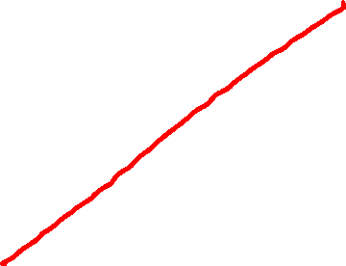
When we have an additional variable
If we have two data points, we can fit a line perfectly between them.

Slide 7
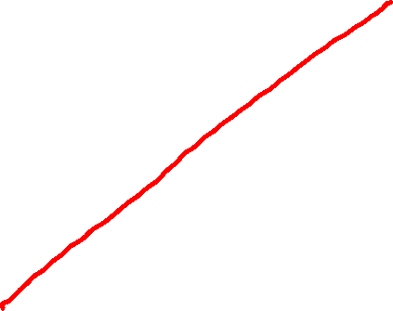
When we have an additional variable
But what if we have more?
In linear algebra, this meant we were overdetermined.

Slide 8
When we have an additional variable
So last week, we fit the line using the least squares estimator.
But how good is this fit?

Slide 9
An Intuitive Look
Pediatric Patients: Estimating Weight
Which of these two is a more effective predictor of weight?
Weight
Weight
Height
Favorite Color

Slide 10

Again: MSE
We look at the vertical distances of the data points to our prediction.
What are these called again?
In this case, we square each of these distances, and take their mean. (MSE)

Slide 11
Simple Linear Regression
Last week we used calculus to find the slope and the y-intercept of the Least Squares Estimator (LSE) line.
We proved that the LSE is the solution that minimizes MSE.

Slide 12
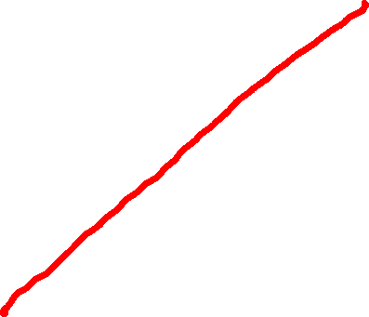
Simple Linear Regression
Think of choosing the slope and y-intercept as rotating the best fit line, and calculating the resulting MSE.

Slide 13


Simple Linear Regression
If we plot that rotation vs MSE, then what we did was select the rotation at the bottom of the curve.
Calculated MSE
$\hat{y}={\hat{β}}_{1}x+{\hat{β}}_{0}$

Slide 14

Simple Linear Regression
With univariate data (just $y_{i}$) we said the best estimate was the mean.
Weight

Slide 15

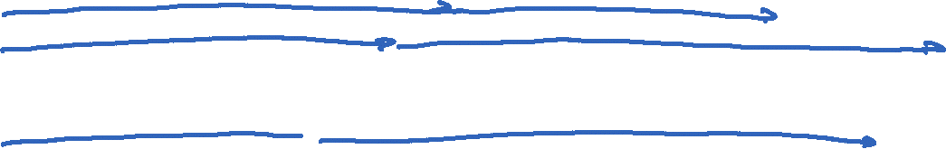
Simple Linear Regression
With two-dimensional data, notice the $y_{i}$ values are the same. They are just ordered differently WRT the predictors $x_{i}$.
Weight
Weight
Weight
Height
Favorite Color

Slide 16

Simple Linear Regression
If the estimator is essentially meaningless, then the slope ${\hat{β}}_{1}=0$ and the y-intercept ${\hat{β}}_{0}=𝔼[Y]$.
Weight
Weight
Favorite Color

Slide 17


Simple Linear Regression
In other words, when the predictor variable is not useful at all, the sums of the squared errors (residuals) is the same as the sum of the squared errors of $\left\{y_{i}\right\}$ by itself, $Var[Y]$.
Weight
Weight
Favorite Color

Slide 18

Takeaway
We can say that predicting $Y$ using just the observed $y_{i}$ itself is the same as predicting $Y$ using $(x_{i},y_{i})$ when the least squares estimator line has zero slope.

Slide 19
Meaningful Predictor
When we do see a predictor variable that appears to have meaning, then we would fit a line with a non-zero slope.
Weight
Height

Slide 20


Simple Linear Regression
In this case, we expect the sum of the squared errors to be less than if we had predicted $Y$ as $𝔼[Y]$.
Weight
Weight
Height

Slide 21
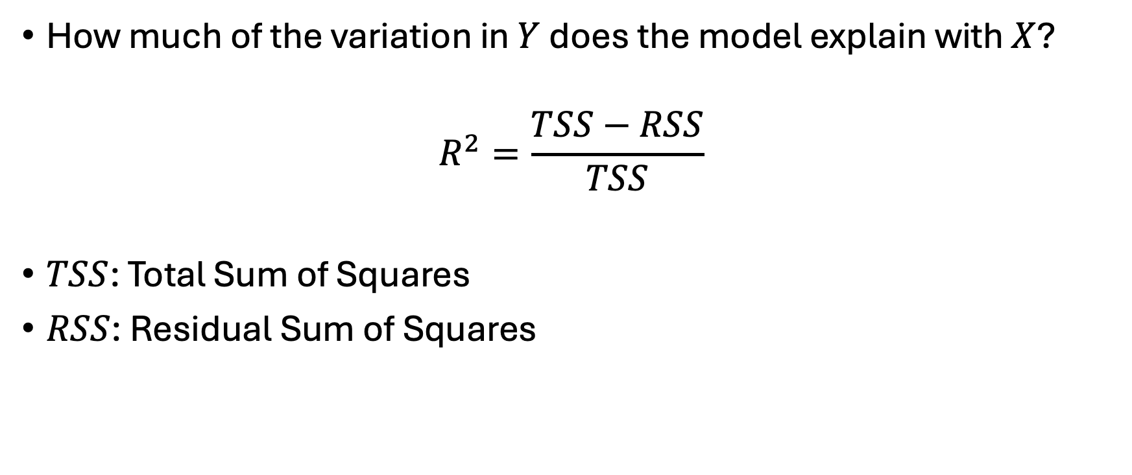
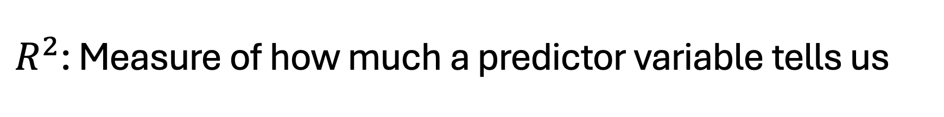
$R^{2}$: Measure of how much a predictor variable tells us
How much of the variation in $Y$ does the model explain with $X$?
$$R^{2}=\frac{TSS−RSS}{TSS}$$
$TSS$: Total Sum of Squares
$RSS$: Residual Sum of Squares

Slide 22

$R^{2}$: Measure of how much a predictor variable tells us
How much of the variation in $Y$ does the model explain with $X$?
$$R^{2}=\frac{SS_{mean only }−SS_{fit}}{SS_{mean only}}$$

Slide 23
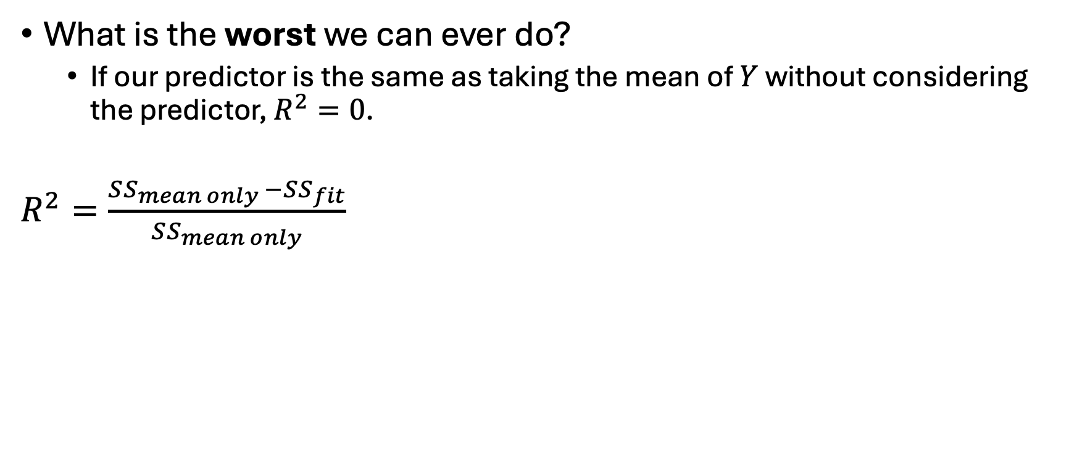

Let’s unpack this some more
What is the worst we can ever do?
If our predictor is the same as taking the mean of $Y$ without considering the predictor, $R^{2}=0$.
$R^{2}=\frac{SS_{mean only }−SS_{fit}}{SS_{mean only}}$
Weight
Weight
Favorite Color

Slide 24
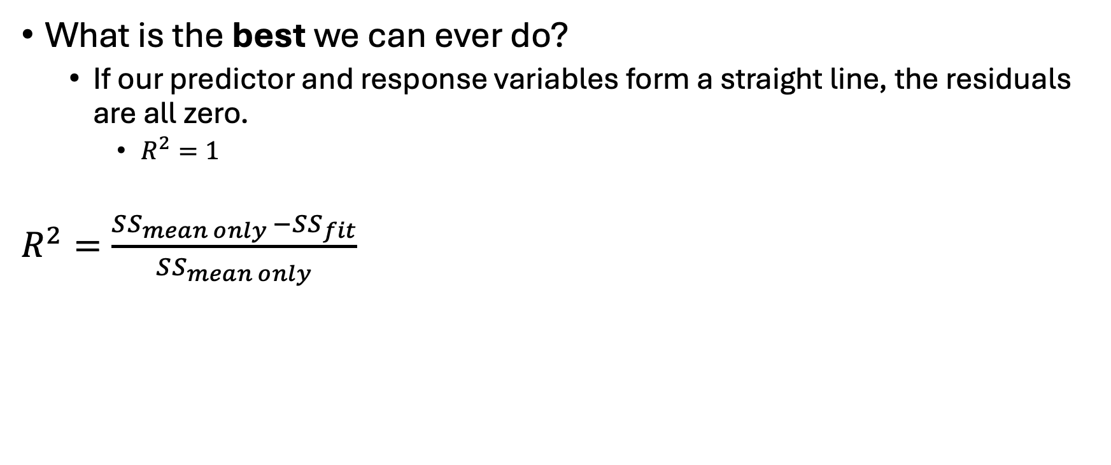

Let’s unpack this some more
What is the best we can ever do?
If our predictor and response variables form a straight line, the residuals are all zero.
$R^{2}=1$
$R^{2}=\frac{SS_{mean only }−SS_{fit}}{SS_{mean only}}$
Weight
Weight
24
Amazing Predictor

Slide 25

Why this works
Recall the first of our “big three” assumptions:
Weight
Weight
Weight
Height
Favorite Color

Slide 26
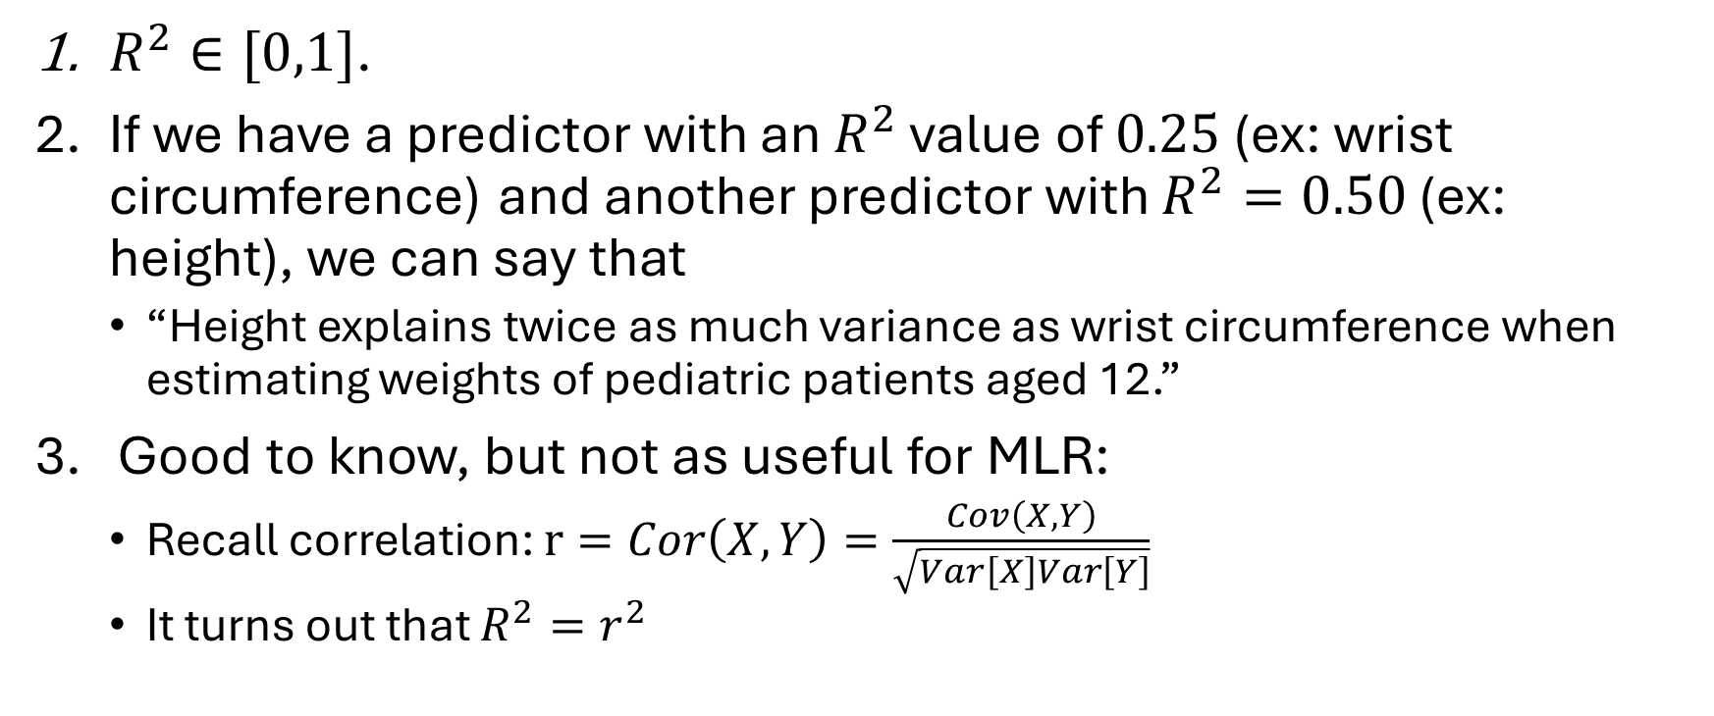
Takeaways
$R^{2}∈[0,1]$.
If we have a predictor with an $R^{2}$ value of $0.25$ (ex: wrist circumference) and another predictor with $R^{2}=0.50$ (ex: height), we can say that
“Height explains twice as much variance as wrist circumference when estimating weights of pediatric patients aged 12.”
Good to know, but not as useful for MLR:
Recall correlation: $r=Cor\left(X,Y\right)=\frac{Cov\left(X,Y\right)}{\sqrt{Var\left[X\right]Var\left[Y\right]}}$
It turns out that $R^{2}=r^{2}$

Slide 27

Limitations
$R^{2}$ doesn’t tell us everything.
Example: What if we had only two data points?

Slide 28

Limitations
Example: What if we had only two data points?
$SSE=0 ⇒R^{2}=1$. A perfect fit!

Slide 29

Limitations
$SSE=0 ⇒R^{2}=1$. A perfect fit!
But what if we start applying it to test data?

Slide 30
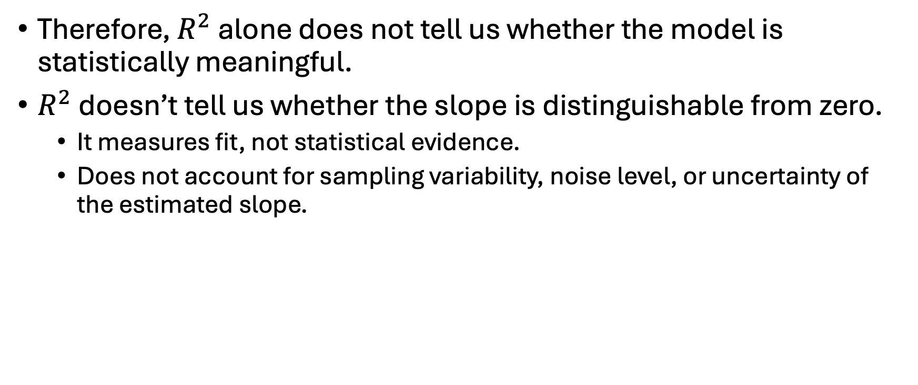
Limitations
Therefore, $R^{2}$ alone does not tell us whether the model is statistically meaningful.
$R^{2}$ doesn’t tell us whether the slope is distinguishable from zero.
It measures fit, not statistical evidence.
Does not account for sampling variability, noise level, or uncertainty of the estimated slope.

Slide 31
Enter: The F-test
We want to get a statistical significance of our fit.

Slide 32
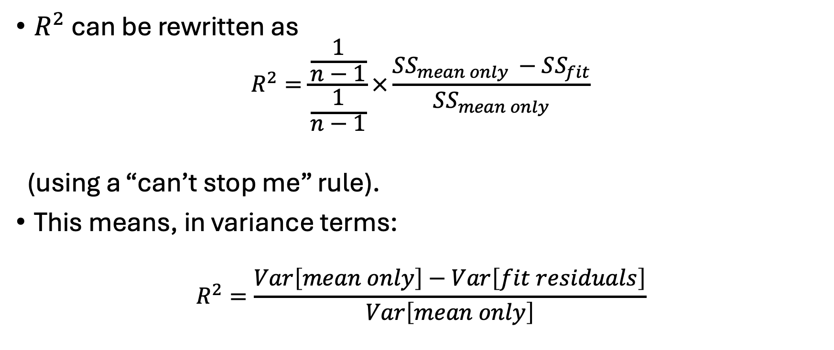

Decomposition and Comparison to $R^{2}$
$R^{2}$ can be rewritten as
$$R^{2}=\frac{\frac{1}{n−1}}{\frac{1}{n−1}}×\frac{SS_{mean only }−SS_{fit}}{SS_{mean only}}$$
(using a “can’t stop me” rule).
This means, in variance terms:
$$R^{2}=\frac{Var\left[mean only\right]−Var\left[fit residuals\right]}{Var\left[mean only\right]}$$

Slide 33
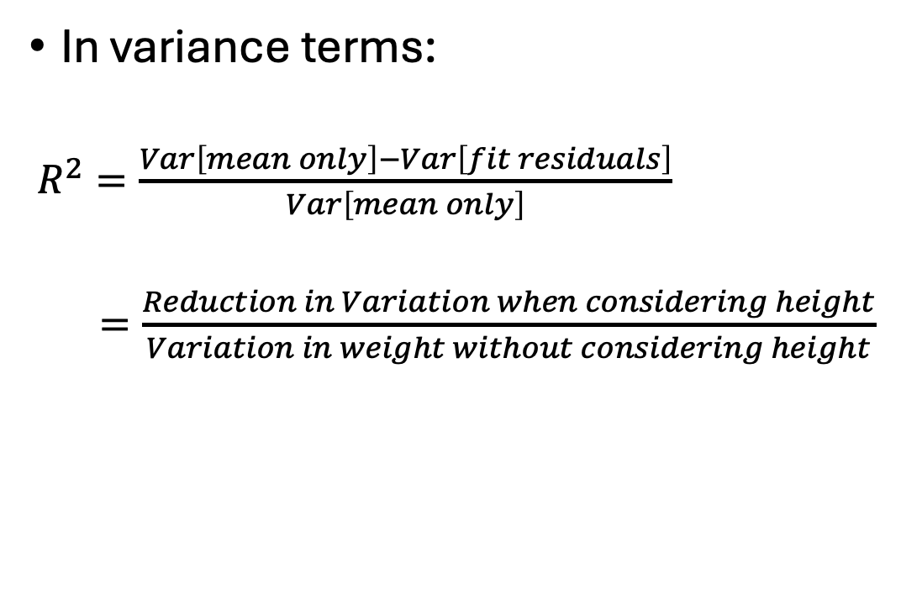
Decomposition and Comparison to $R^{2}$
In variance terms:
$R^{2}=\frac{Var\left[mean only\right]−Var\left[fit residuals\right]}{Var\left[mean only\right]}$
$=\frac{Reduction in Variation when considering height}{Variation in weight without considering height}$
Weight
Weight
Height

Slide 34
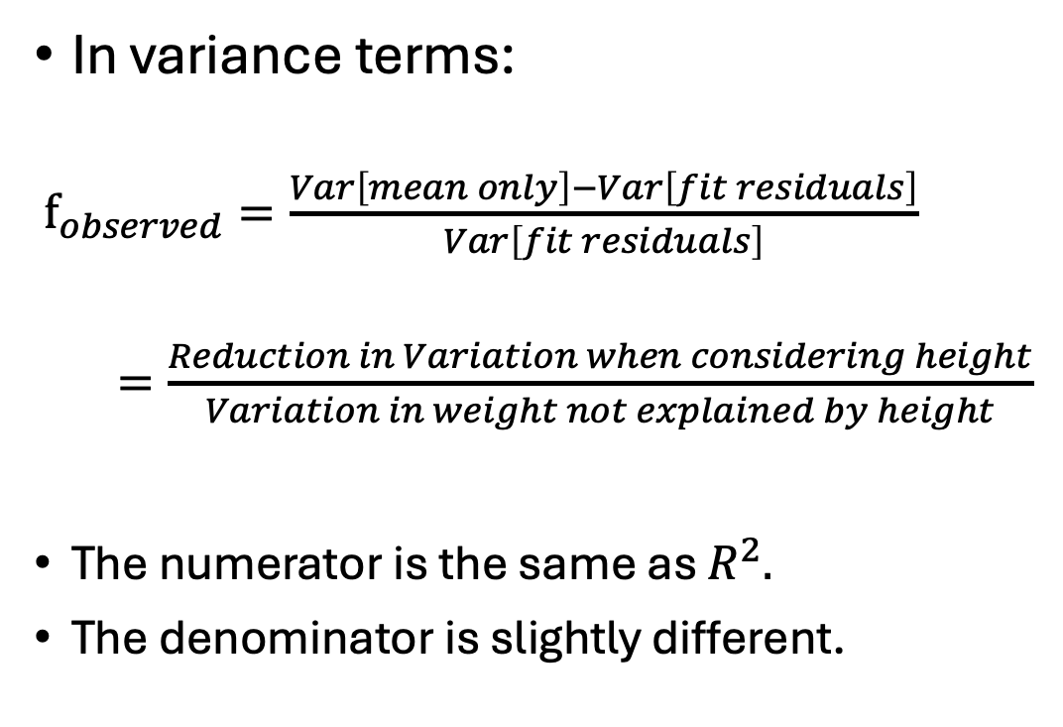
F-statistic
In variance terms:
$f_{observed}=\frac{Var\left[mean only\right]−Var\left[fit residuals\right]}{Var\left[fit residuals\right]}$
$=\frac{Reduction in Variation when considering height}{Variation in weight not explained by height}$
The numerator is the same as $R^{2}.$
The denominator is slightly different.
Weight
Weight
Height

Slide 35
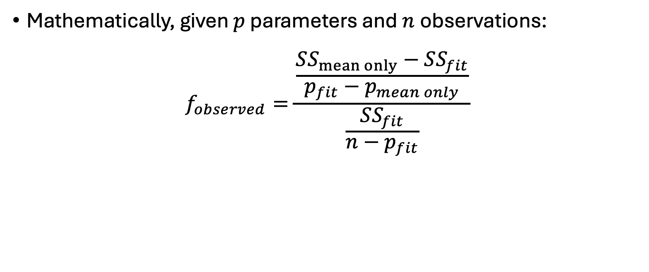
F-statistic
Mathematically, given $p$ parameters and $n$observations:
$$f_{observed}=\frac{\frac{SS_{mean only}−SS_{fit}}{p_{fit}−p_{mean only}}}{\frac{SS_{fit}}{n−p_{fit}}}$$

Slide 36
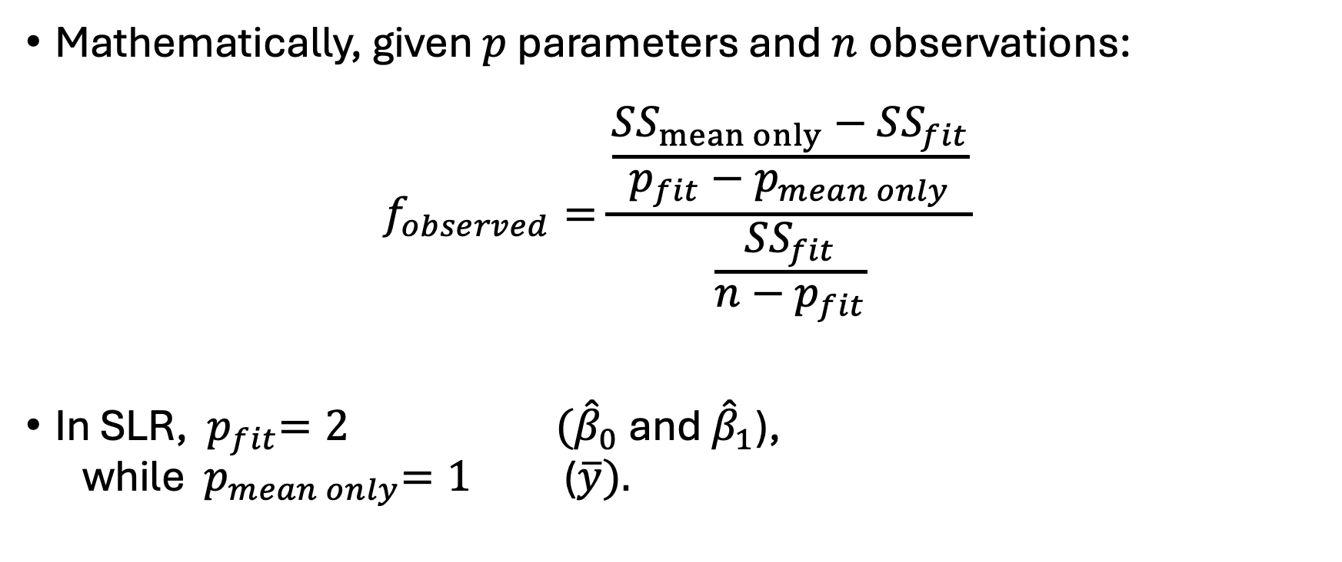
F-statistic
Mathematically, given $p$ parameters and $n$observations:
$$f_{observed}=\frac{\frac{SS_{mean only}−SS_{fit}}{p_{fit}−p_{mean only}}}{\frac{SS_{fit}}{n−p_{fit}}}$$
In SLR, ${ p}_{fit}=2 ({\hat{β}}_{0}$ and ${\hat{β}}_{1}$), while ${ p}_{mean only}=1$ ($\overline{y}).$

Slide 37
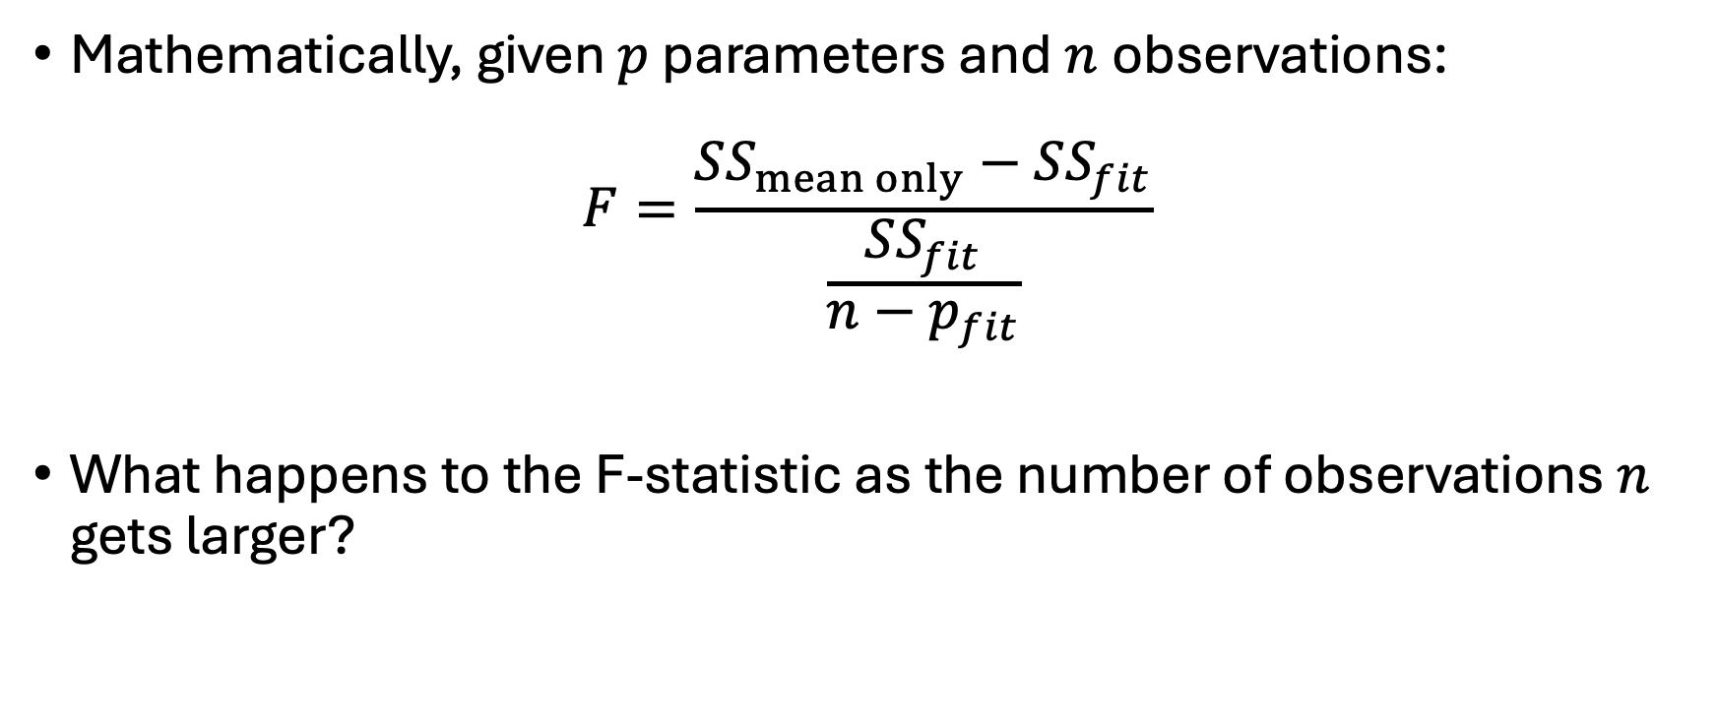
F-statistic
Mathematically, given $p$ parameters and $n$observations:
$$F=\frac{SS_{mean only}−SS_{fit}}{\frac{SS_{fit}}{n−p_{fit}}}$$
What happens to the F-statistic as the number of observations $n$ gets larger?

Slide 38
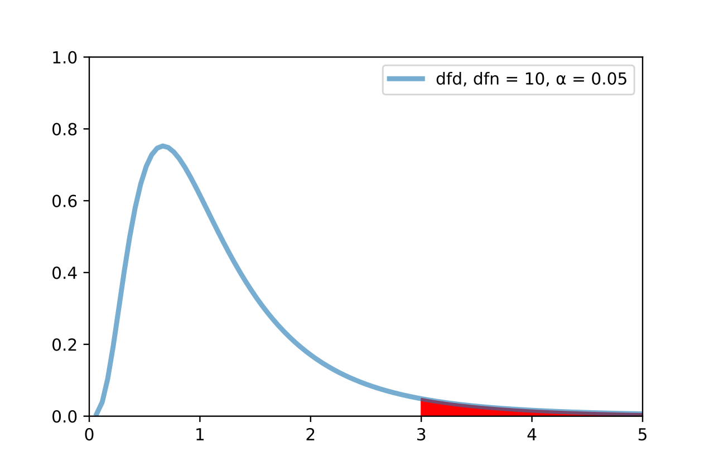

The F-Distribution
We then use the F-Distribution to calculate a p-value.
$$p=𝒫(F_{df\left(numerator\right),df\left(denominator\right)}≥f_{observed})$$
Image adapted from F-test plot.svg, Gase456, CC by 4.0. Retrieved from https://en.wikipedia.org/wiki/F-test.

Slide 39
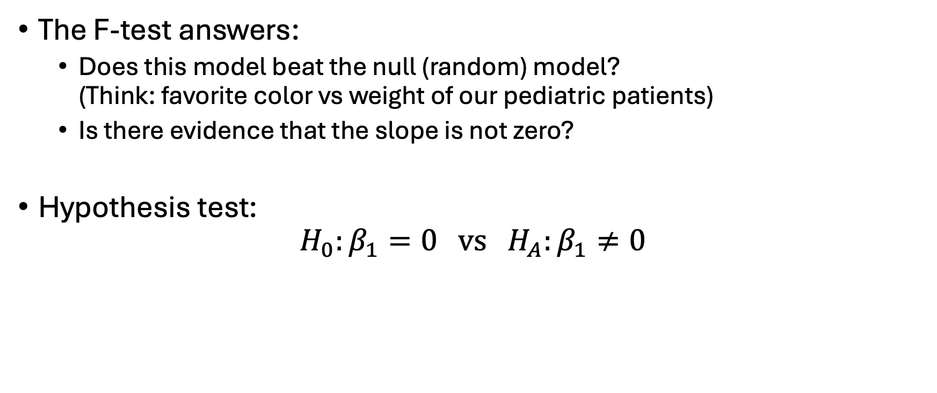
Mathematical Interpretation
The F-test answers:
Does this model beat the null (random) model? (Think: favorite color vs weight of our pediatric patients)
Is there evidence that the slope is not zero?
Hypothesis test:
$$H_{0}:β_{1}=0 vs H_{A}:β_{1}≠0$$

Slide 40
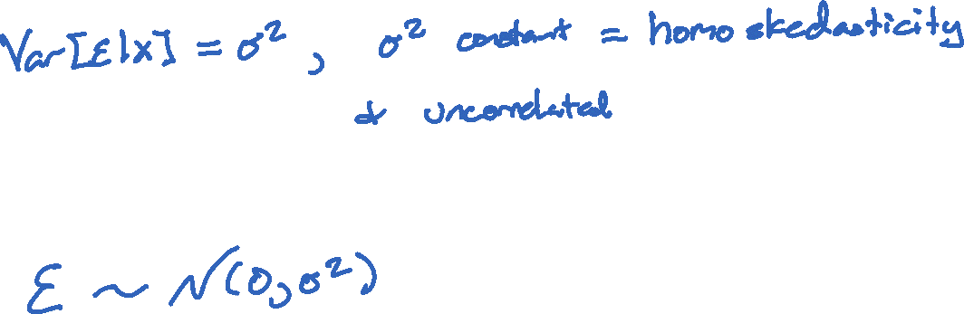
Why this works
Recall the second “big three” assumption:
And the third “big three” assumption:
And the uncorrelated assumption from #2 automatically gives us independence with the Normal/Gaussian assumption.

Slide 41
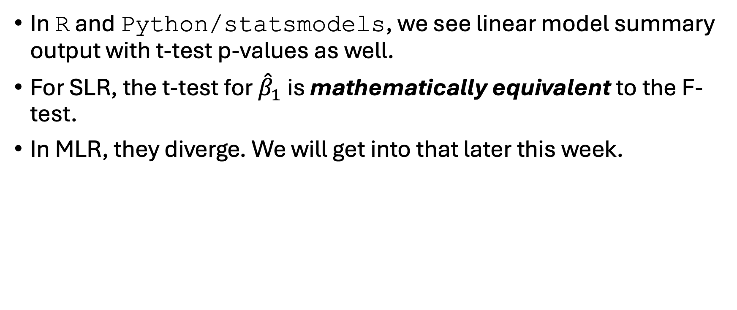
What about the t-tests?
In R and Python/statsmodels, we see linear model summary output with t-test p-values as well.
For SLR, the t-test for ${\hat{β}}_{1}$ is mathematically equivalent to the F-test.
In MLR, they diverge. We will get into that later this week.

Slide 42
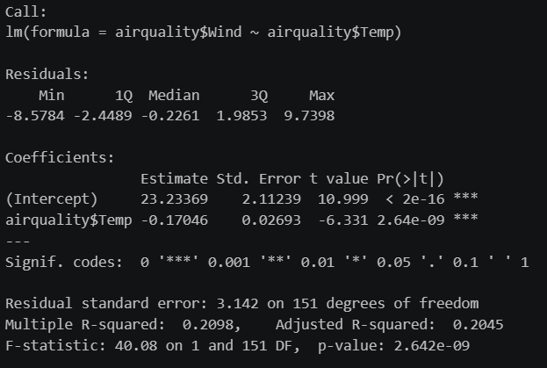


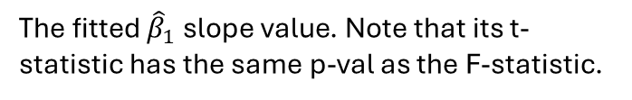
R Output
Recall that in R we use the fit <- lm()command. The summary of that fit looks like this:
The Y (response) regressed onto X (predictor).
The distribution of the residuals.
The fitted ${\hat{β}}_{0}$ y-intercept value.
The fitted ${\hat{β}}_{1}$ slope value. Note that its t-statistic has the same p-val as the F-statistic.
The $R^{2}$value. More on adjusted $R^{2}$ in MLR.
F-statistic and its p-value.

Slide 43
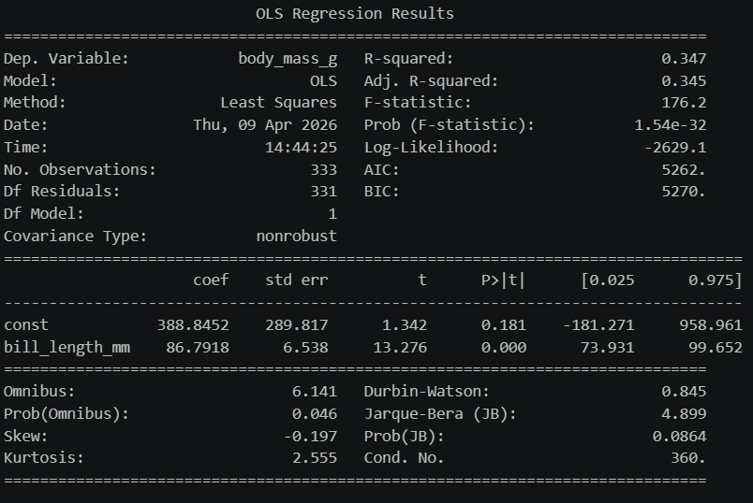



Python Output
In Python, with statsmodels imported as sm, we build a design matrix (more on that tomorrow) and the output looks like:
The Y (response) is the dependent variable.
The X (predictor) variable.
The $R^{2}$value.
F-statistic and its p-value.
The fitted ${\hat{β}}_{0}$ y-intercept value.
The fitted ${\hat{β}}_{1}$ slope value.

Slide 44

Back to R and Python
Open up your notebooks and datasets from Thursday.
Using visual EDA (scatterplot matrices and/or correlation heatmaps), compare $R^{2}$ values and F-test p-values between different variables.

Slide 45
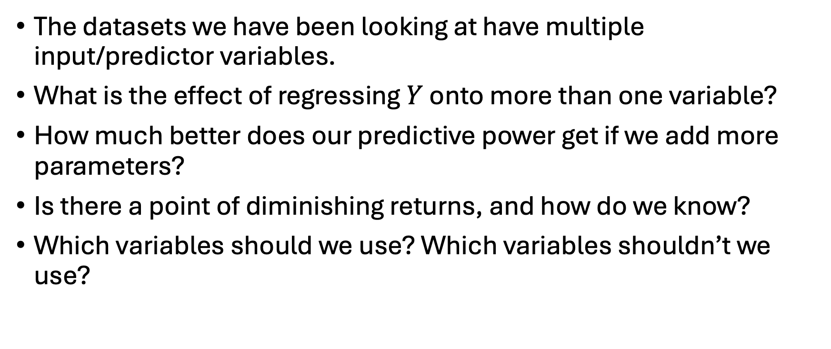
Later …
The datasets we have been looking at have multiple input/predictor variables.
What is the effect of regressing $Y$ onto more than one variable?
How much better does our predictive power get if we add more parameters?
Is there a point of diminishing returns, and how do we know?
Which variables should we use? Which variables shouldn’t we use?

